Slide 1

Computer Engineering Department
A.P. Shah Institute of Technology
G.B.Road,Kasarvadavli, Thane(W), Mumbai-400615
UNIVERSITY OF MUMBAI

Slide 2
Group Members Name and Roll No. :
Ghanshyam Kachhia 72 (20102026)
Vansh Jeetendra Jain 69 (20102156)
Vansh Virendra Jain 70 (21202005)

Slide 3
Blood Bank Management System

Slide 4
Problem Definition
Inefficient blood inventory management, leading to shortages or wastage of blood products.
Lack of a centralized database to track blood donations, storage, and distribution, making it difficult to manage and access information.
Manual processes for recording and tracking blood inventory, leading to errors and delays in record keeping and blood tracking.

Slide 5
Hardware Requirements
RAM: 32 GB.
Disk space: 500 GB.
CPU cores: 32.
Processor speed: 2.3 GHz or more. The processor must support Page Address Extension. Comparable to an Intel Xeon 6250 processor, or to an AMD EPYC 7502P processor.

Slide 6
Software Requirements
HTML
CSS
Php
DataBase(Xampp)
AWS Services
1. AWS Elastic Cloud Compute
2. AWS Security Groups
3. AWS Remote Desktop

Slide 7
Services used in the Project
1. AWS Elastic Cloud Compute
Amazon Elastic Compute Cloud (EC2) is a web service provided by Amazon Web Services (AWS) that offers resizable compute capacity in the cloud. EC2 allows users to launch virtual machines (EC2 instances) on the AWS cloud, with a variety of operating systems, software configurations, and instance types to choose from. Users can also configure security and networking settings for their EC2 instances, and scale their resources up or down as needed. EC2 is widely used for a variety of workloads, including web applications, big data processing, and enterprise applications.

Slide 8
2. AWS Security Groups
AWS Security Groups are virtual firewalls that control the traffic to and from Amazon Elastic Compute Cloud (EC2) instances. They allow users to define inbound and outbound network traffic rules for their EC2 instances, based on IP protocols, ports, and source or destination IP addresses. Security Groups act as a first line of defense against unauthorized access and provide network-level security for EC2 instances. They are easy to configure, apply at the instance level, and can be changed dynamically, making them a flexible and scalable way to control network traffic in the AWS cloud.

Slide 9
3. AWS Remote Desktop
AWS Remote Desktop is a cloud-based remote desktop service that allows users to access their Windows desktops and applications from anywhere, using any device with an internet connection. It provides a fully managed desktop experience, with features like automatic software updates, backups, and security patches. Users can easily provision and manage virtual desktops in the AWS cloud, and can use them to run applications, access files, and collaborate with team members remotely. AWS Remote Desktop also offers a variety of security features, such as multi-factor authentication, network isolation, and encryption, to ensure the protection of user data and applications. Additionally, it provides an easy-to-use management console and integrates with other AWS services, making it a flexible and scalable solution for remote desktop access.

Slide 10
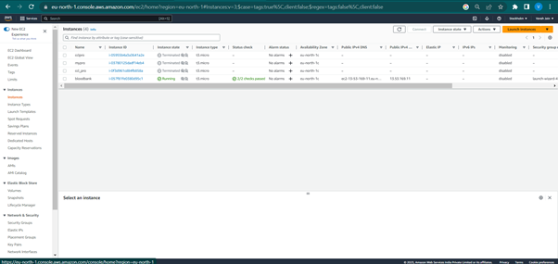
Project Snapshots

Slide 11
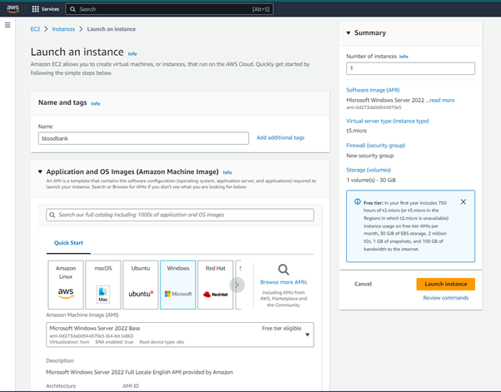
AWS Elastic Cloud Compute

Slide 12
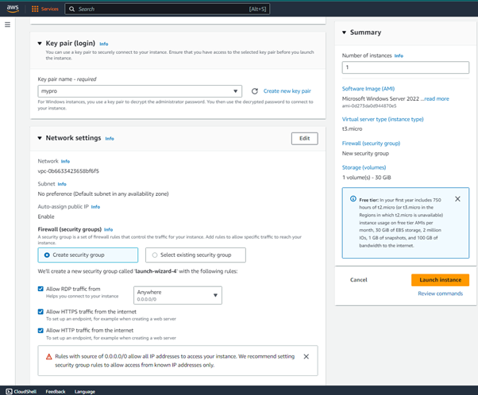
AWS Security Groups

Slide 13
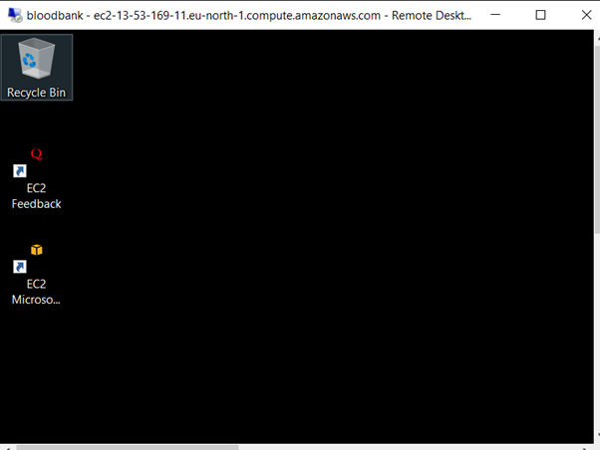
AWS Remote Desktop

Slide 14
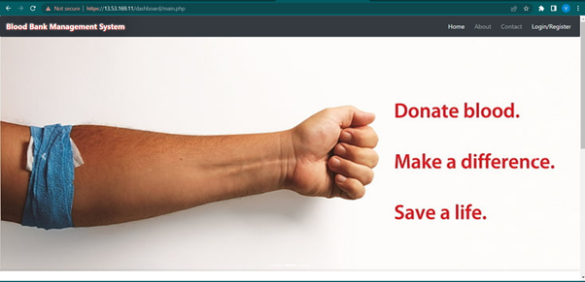
Front End

Slide 15
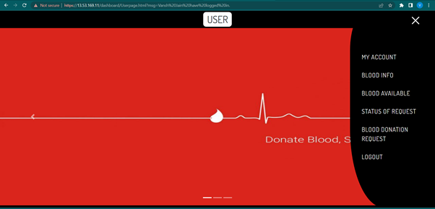
Front End

Slide 16
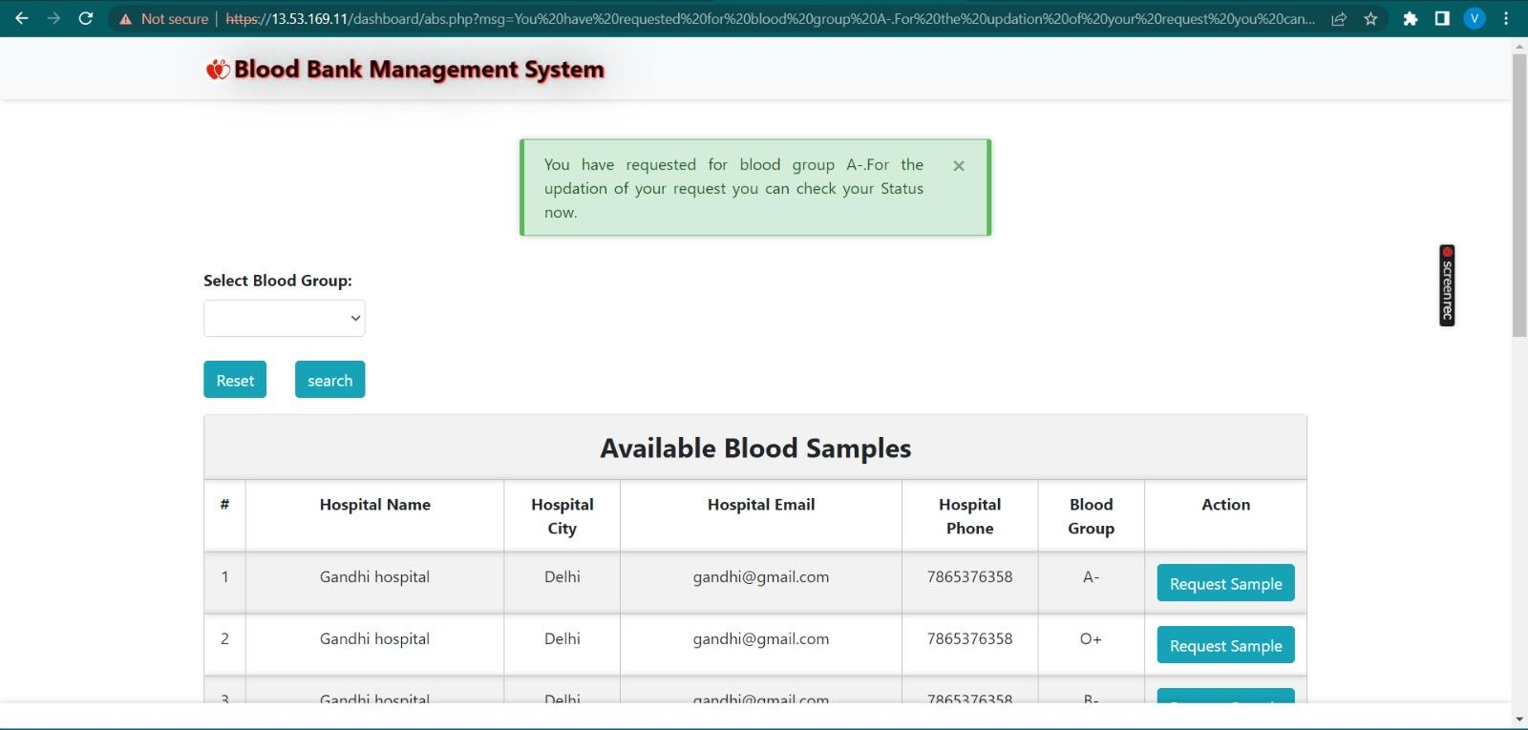
Front End

Slide 17
THANK YOU

